Slide 1
COMP 3500 Introduction to Operating Systems Resource Allocation Graphs Handling Deadlocks
Dr. Xiao Qin
Auburn University http://www.eng.auburn.edu/~xqin
xqin@auburn.edu
Slides are adopted from Drs. Silberschatz, Galvin, and Gagne
Notes:
20 Min: google engineers gave a talk.
30 Min: Slides 1-8

Slide 2
Recap: Deadlock Characterization
Deadlock can arise if four conditions hold simultaneously.
Mutual exclusion: only one process at a time can use a resource
Hold and wait: a process holding at least one resource is waiting to acquire additional resources held by other processes
No preemption: a resource can be released only voluntarily by the process holding it, after that process has completed its task
Circular wait: there exists a set {P₀, P₁, …, P_{n}} of waiting processes such that … …

Slide 3
Recap: Resource-Allocation Graph
Process
Resource Type with 4 instances
P_{i} requests instance of R_{j}
P_{i} is holding an instance of R_{j}
P_{i}
R_{j}
P_{i}
R_{j}

Slide 4
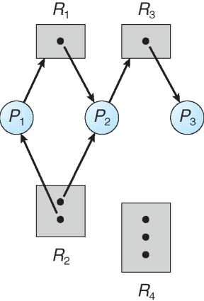
Q1: Can you explain this resource allocation graph?

Slide 5
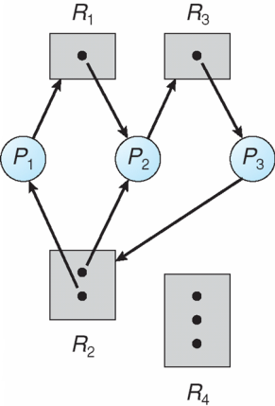
Q2: Is there any problem with this resource allocation graph?
Notes:
Answer: deadlock

Slide 6
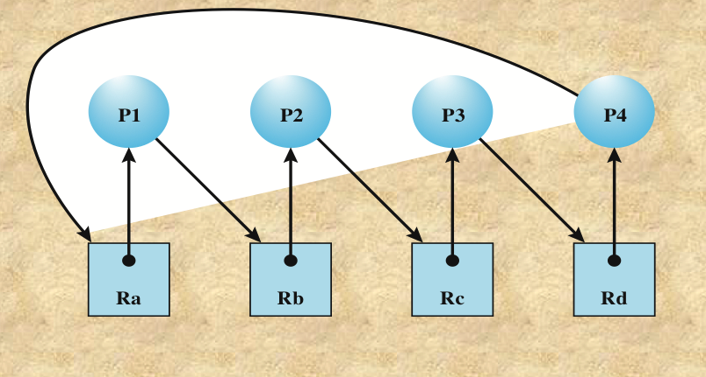
Q3: Is there any problem with this resource allocation graph?
Notes:
Answer: deadlock

Slide 7
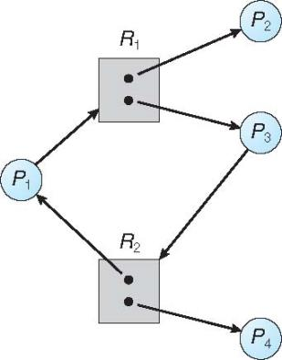
Q4: The graph below has a cycle. Is this a deadlock? Why?
Notes:
No.

Slide 8



Q5: Can you draw the following conclusions?
If graph contains no cycles ⇒ no deadlock
If graph contains a cycle ⇒
if only one instance per resource type, then deadlock
if several instances per resource type, then possibility of deadlock
Notes:
Deadlock or no deadlock?
Why no cycle then no deadlock? No circular wait (one of the four conditions)

Slide 9
Summary
Resource-Allocation Graph
Deadlock Detection using Resource-Allocation Graphs

